Slide 1
Math Game
Week 5 and 6 Progress
By: Gavin Davy, Michael Erickson, and Rena Sakai

Slide 2
SE 2200
Status Report #: | 1 | Date From: | 09/21/20 | Date To: | 10/04/20
Project Title: | Untitled Math Game

Slide 3
Team Members:
Team Members
Gavin Davy
Michael Erickson
Rena Sakai

Slide 4
Meeting Minutes Week 5
Date: | 09/23/20 | Time: | 2PM - 3PM
Who Attended? | What was discussed?
Gavin | Progress Report, SRS-SDD Status Report, and Feasibility Study
Michael | Create an education game, Progres week 5 and 6
Rena | Progres SRS-SDD

Slide 5
Meeting Minutes Week 5
Date: | 09/24/20 | Time: | 2PM - 3PM
Who Attended? | What was discussed?
Gavin | Your First App: Create an Educational Game (Part II) and Progress Report Requirements
Michael | Continued progress of SRS document
Rena | Create an education game, Progres week 5 and 6
 | Progress on Feasibility Study

Slide 6
Meeting Minutes Week 6
Date: | 09/28/2020 | Time: | 3PM - 4PM
Who Attended? | What was discussed?
Michael | Video presentation of Progress Report for extra credit
Rena | Progress on this week’s Action Items

Slide 7
Meeting Minutes Week 6
Date: | 09/30/2020 | Time: | 2PM-3PM
Who Attended? | What was discussed?
Gavin | Group Progress
Michael | Meeting time for creating video presentation of progress
Rena | Plans for next 2 weeks

Slide 8
Action Items Week 5 and Week 6
Action Items | Summary of Progress
Complete SRS-SDD Status Report | SRS-SDD document is underway. Not complete.
Create Questionnaire-based Feasibility Study | Feasibility Study document is completed.
Complete Week 5 and 6 Progress Report | Progress Report is being modified as information is available.

Slide 9
This Weeks Accomplishments
Team Member | Description of task | Hours Spent | Problems Encountered & Solutions
Michael | Format and input on Progress Report | 2 | Requirements found in grading rubric
 | Begin drafting Feasibility Study | 2
Gavin | Started/Continued filling of SRS document | 2 | What is necessary to fill out in the SRS document? What is unnecessary to fill in?
Rena | Made share drive and started filling of SRS document | 1
Michael | Begin creating app screens | 2 | How do we want to format the screens?

Slide 10
This Weeks Accomplishments Continued
Team Member | Description of task | Hours Spent | Problems Encountered & Solutions
Rena | Creating user screen | 2

Slide 11
Project Submissions
Individual Group Work

Slide 12
Contributions from Gavin
I have done a cursory look through the SRS document and filled in the information applicable and accessible to us at this time.

Slide 13
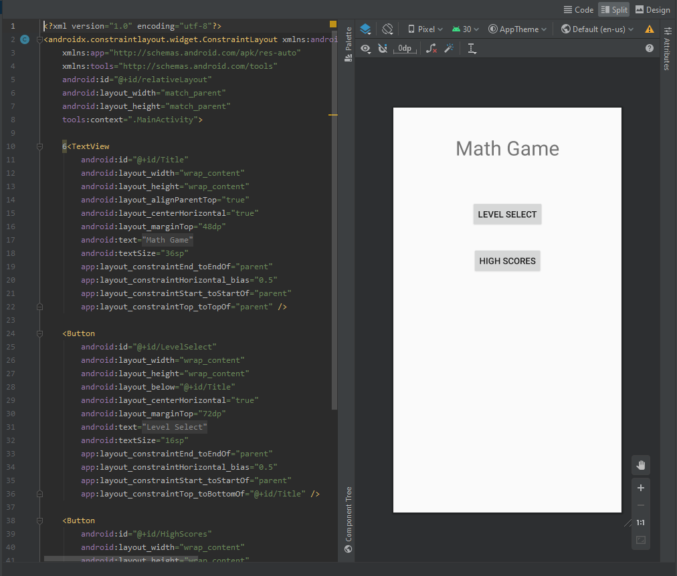
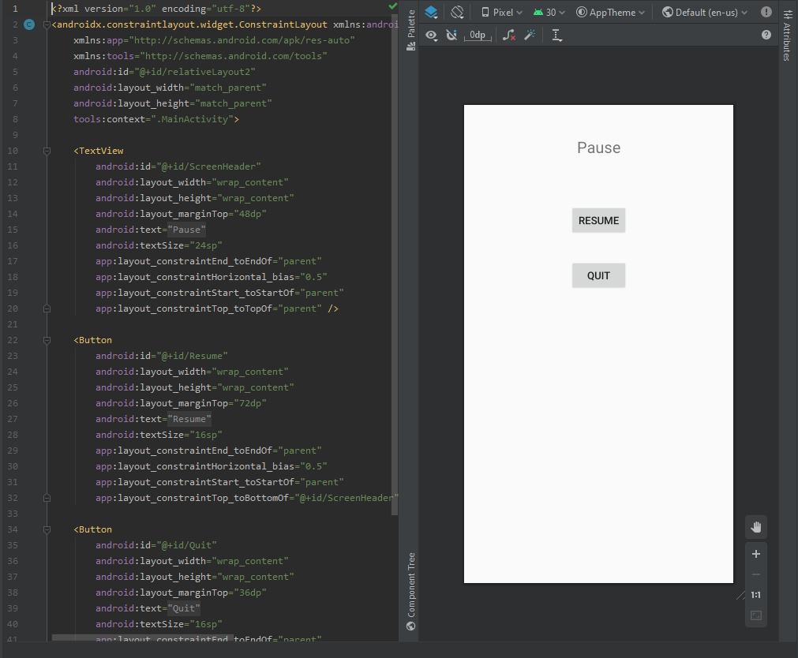
Contributions from Michael
Pictured are rough outlines of the TextViews for the Title and Pause Screen

Slide 14
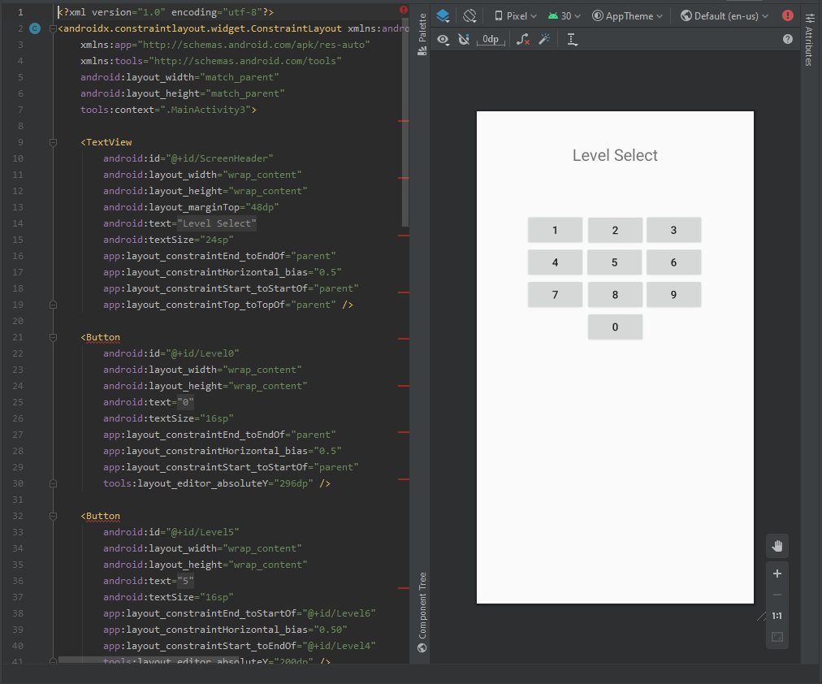
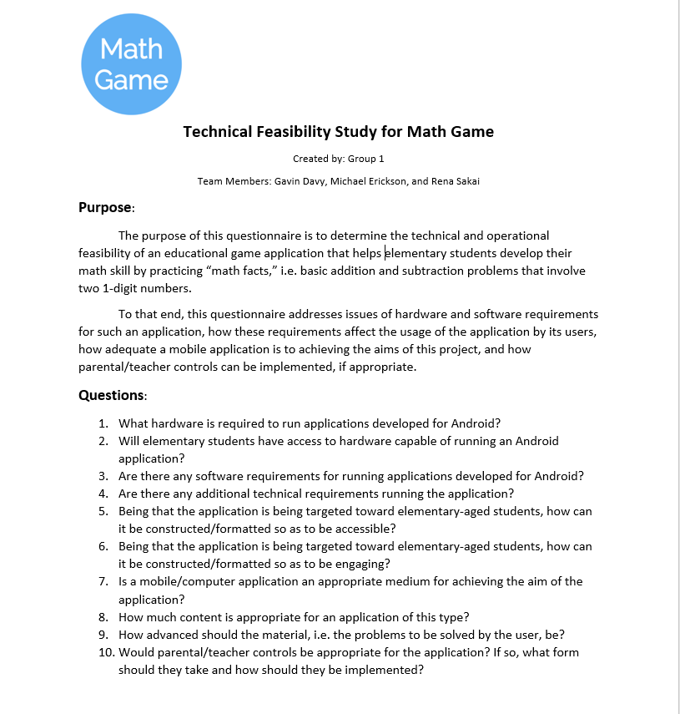
Contributions from Michael
Pictured is the TextView for the Level Select screen and the questionnaire-based technical/operational feasibility report

Slide 15
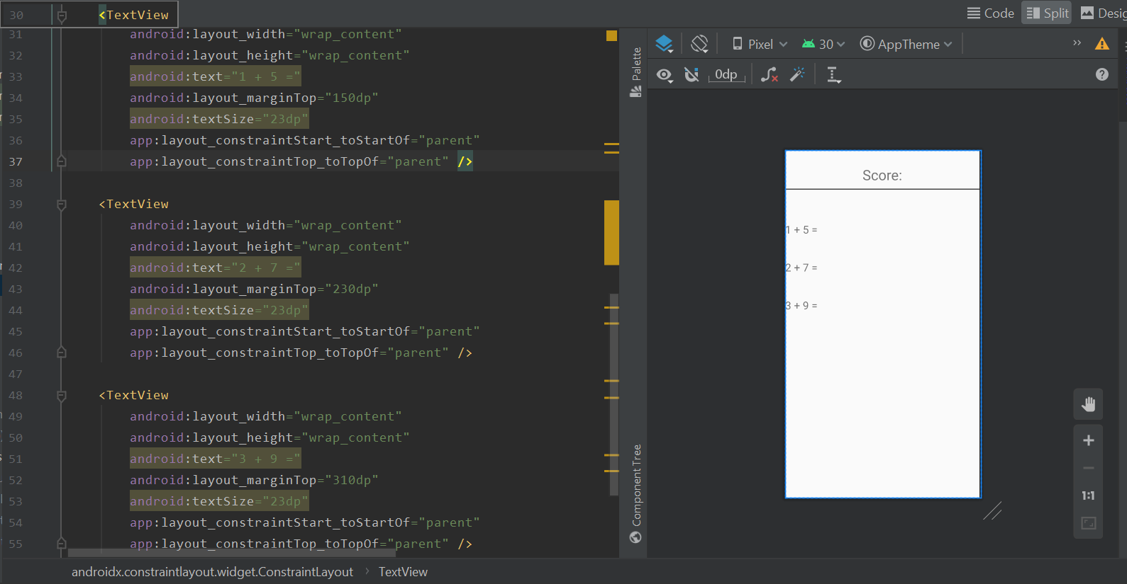
Contributions from Rena
Started making user screens

Slide 16
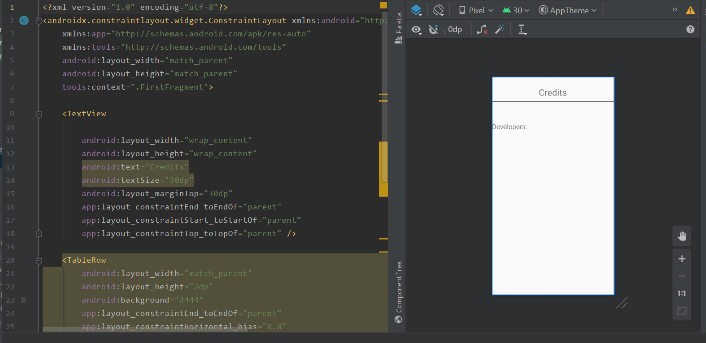
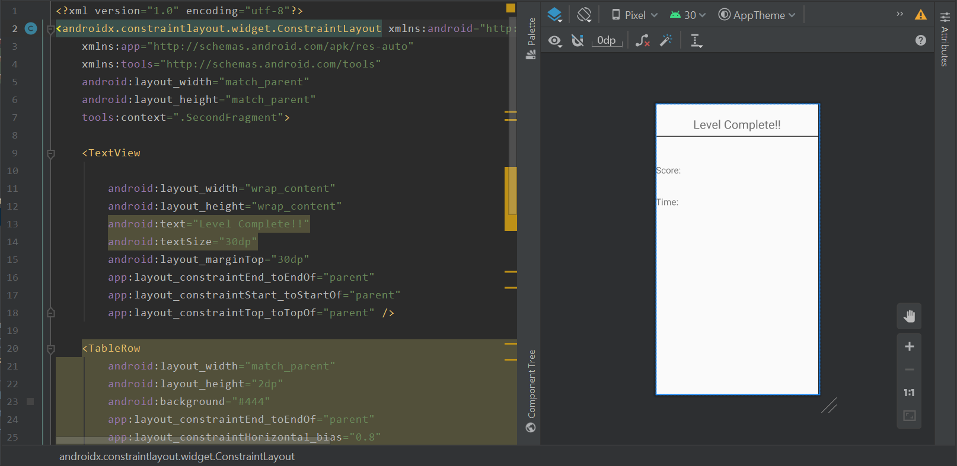

Slide 17
Next Two Weeks’ Plans:
Finish app screens
Create links between screen, as appropriate

